Slide 1


Mini Project
Review I
R.M.K. Engineering College
(An Autonomous Institution)
R.S.M. Nagar, Kavaraipettai-601 206, Gummidipoondi Taluk, Thiruvallur District.
Affiliated to Anna University, Chennai / Approved by AICTE, New Delhi. Accredited by NAAC with A+ Grade / ISO 9001 : 2015 Certified Institution.
All the UG Programs are Accredited by NBA, New Delhi.
Project Title : Coding club
Team Members
JOSEPH RIO JACOB T J – 111719104066
HAREESH R – 111719104058
GOWTHAMEN RAJ R – 111719104056

Slide 2
1. Introduction
The Ideology of this project is to open an online coding portal allowing the students to learn coding more practically by training them to solve the real-time problems faced by our society technically.

Slide 3
1.1 Problem Statement
One of the problems faced by students who are interested in increasing their coding skills and gaining new skills is that they don’t get proper guidance from the expertise in what to learn and where to learn from.
And the other major problem is that they don’t have right resources to learn from and even if they get resources after spending long time in searching and finding the right resources that suits their current level of coding, They again have to search for a website to test their skills they have learnt, For Example : Ethical Hacking. There is also a possibility of them losing their interest in that concepts.
And also there are not many resources available in the internet on many topic and sometimes accessing these resources might cost them more than they could afford

Slide 4
1.2 Objective
The main objective of this website is to make sure that the students increase their coding skills by providing the the necessary resources (Both Documented and recorded videos)for free and providing an environment in which they can test their skills by solving real-world problems faced by our society.
We also aim at providing daily coding challenges to get knowledge and improve their skills by doing advanced - level programs.

Slide 5
2.Literature Survey Result
Targeted Audience (II year and Upcoming Batches of RMKEC CSE & ADS)
Literature Survey review approved by
        Dr. Sethukarasi.T M.E.,Ph.D
        Dr. Sandra Johnson M.E.,Ph.D.
        Dr.Geetha.C M.E., Ph.D.
Survey Conducted with Google Form

Slide 6
3. Hardware and Software Used
3.1 Hardware Used
1.Node Server
2.React Server
3.2 Software Used
1.Firebase
2.React Js
3.HTML
4.CSS
5.Javascript
6.Bootstrap
7.MySql
8.GitHub
9.VS
10.Material UI

Slide 7
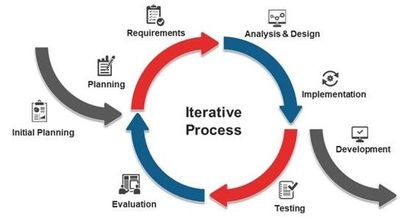
4. Methodology

Slide 8
Methodology
In this Model, you can start with some of the software specifications and develop the first version of the software. After the first version if there is a need to change the software, then a new version of the software is created with a new iteration. Every release of the Iterative Model finishes in an exact and fixed period that is called iteration.
The Iterative Model allows the accessing earlier phases, in which the variations made respectively. The final output of the project renewed at the end of the Software Development Life Cycle (SDLC) process.

Slide 9
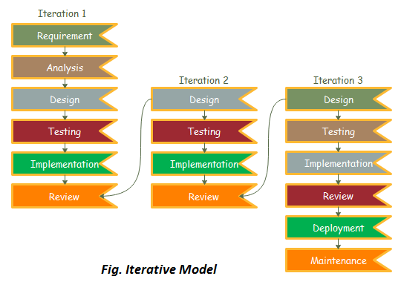
Methodology
The Iterative Model allows the accessing earlier phases, in which the variations made respectively. The final output of the project renewed at the end of the Software Development Life Cycle (SDLC) process.

Slide 10
5. Expected Results
The major purpose of this project is to make students understand the concept with less time and effort.
Students can learn the concepts and improve their skills in coding within a short span of time.

Slide 11
6. References
HTML - https://www.coursera.org/learn/html
CSS - https://www.w3schools.com/css
JAVASCRIPT - https://www.w3schools.com/js
PHP & MySQL -https://www.youtube.com/watch?v=pWG7ajC_OVo&list=PL4cUxeGkcC9gksOX3Kd9KPo-O68ncT05o
React JS -
https://www.youtube.com/watch?v=MJzbJQLGehs

Slide 12


